Slide 1


Web Security
Let’s Hack to Protect!
˘=
Alain Tiemblo
Security Lead Developer

Slide 2

About Me
Alain Tiemblo
Web Security Lead Developer @ BlaBlaCar

Slide 3

Why does security matter?

Slide 4
Disclaimer!
The following example is something
I did years ago…!
Now I am an angel

Slide 5
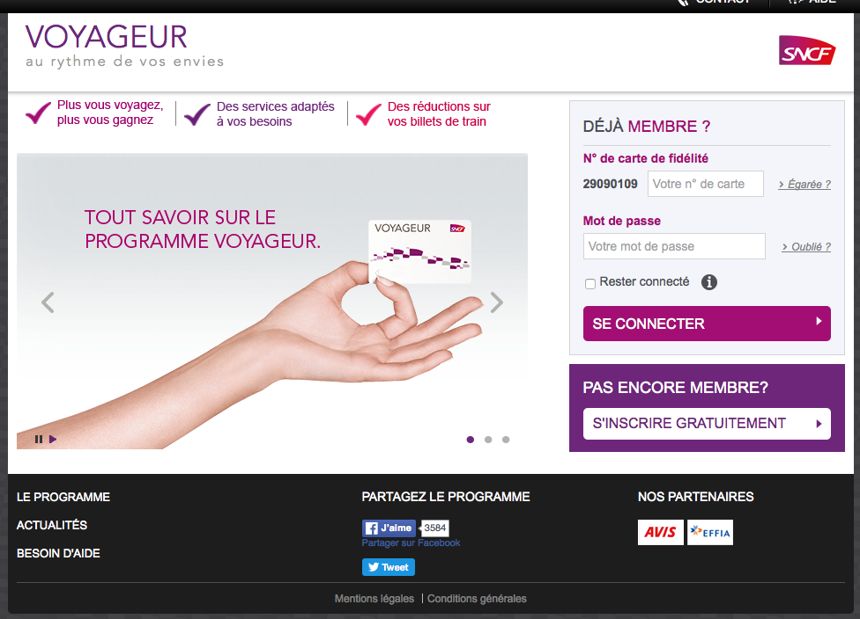


Slide 6
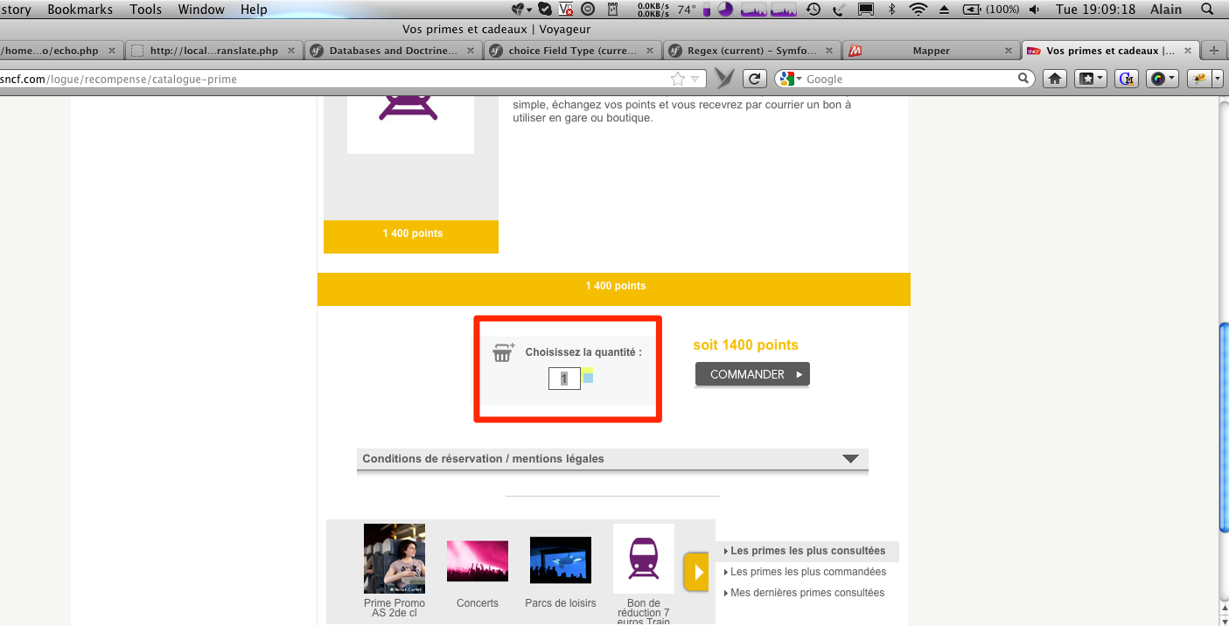

Slide 7
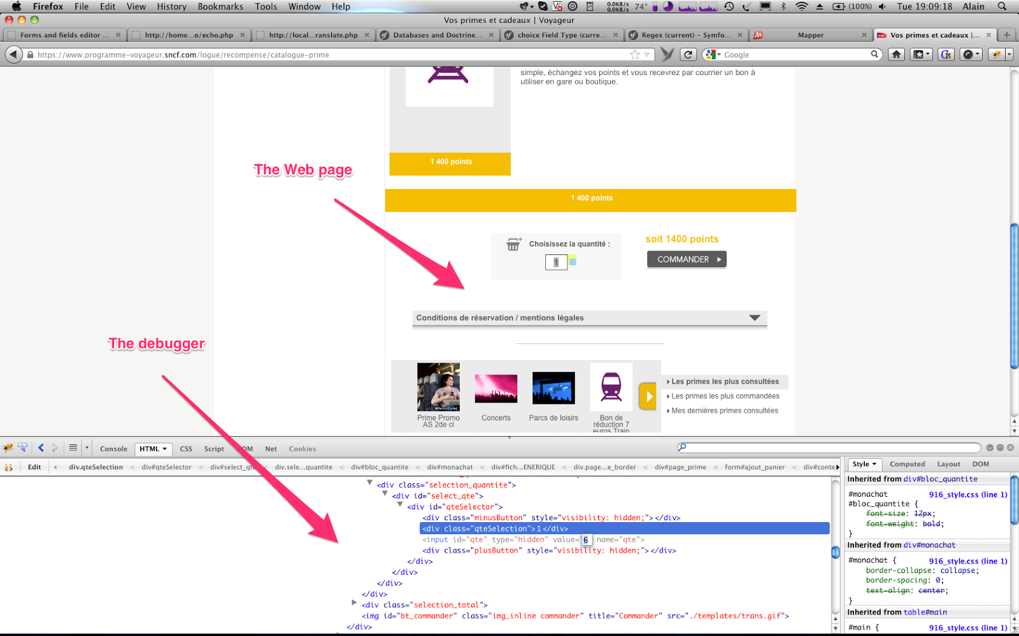

Slide 8
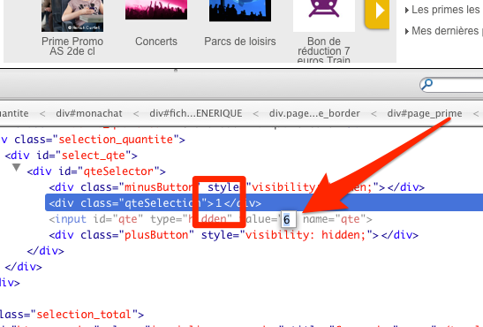

Slide 9
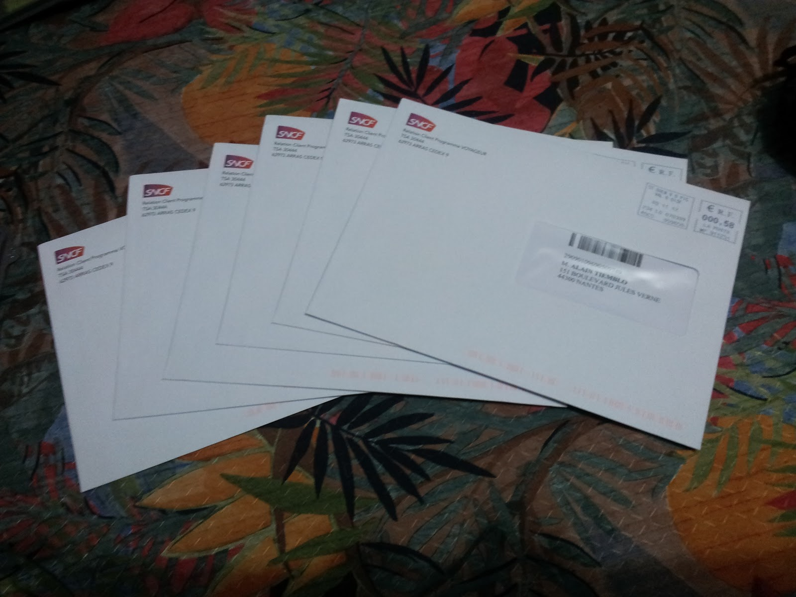

Slide 10
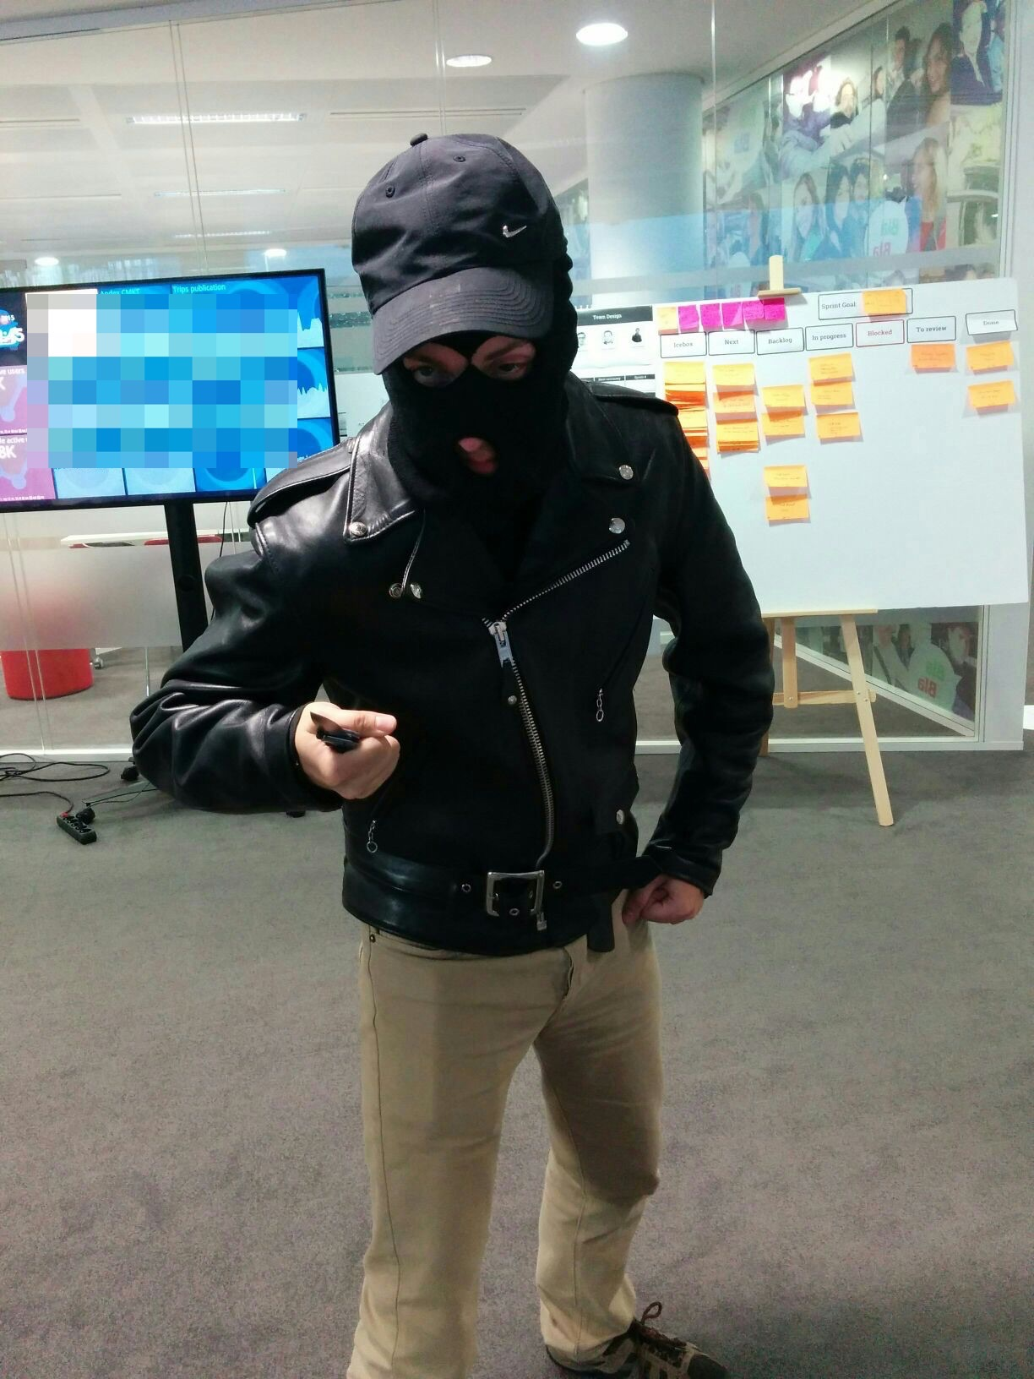

Slide 11

Password Hashing

Slide 12
Do not store passwords clear!
Compromising of databases
Company’s responsibility

Slide 13
Hashing just the password is bad!

Slide 14
Hint:
“Based on 15 millions Google accounts, 50% of users choose from the same ~1 million passwords”

Slide 15
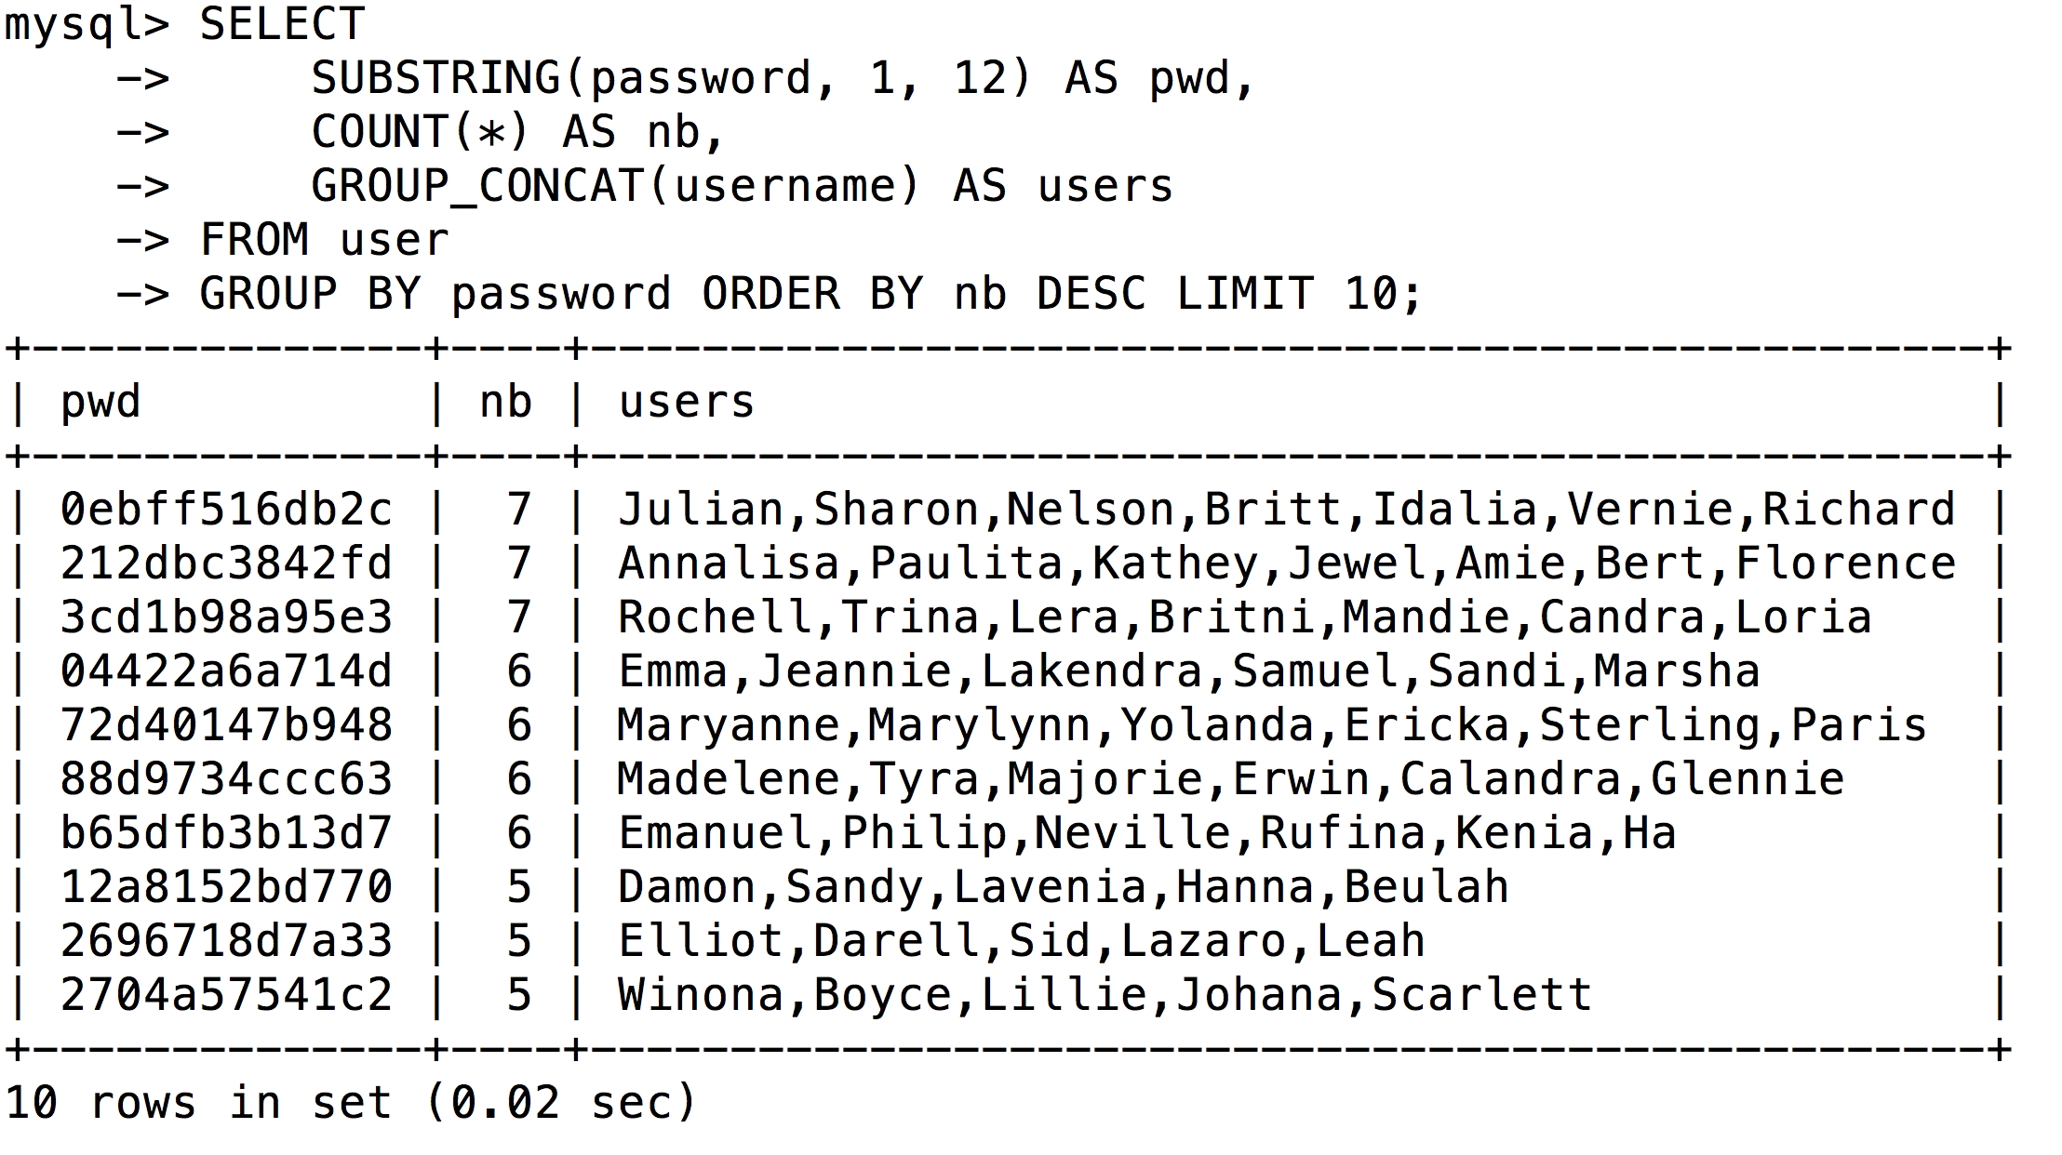

Slide 16
Solutions
concatenate password with a unique salt per user
use a more complex algorithm such as bcrypt

Slide 17





They leaked data :(
Adobe
152M accounts
Ashley Madison
31M accounts
000webhost
14M accounts
gamigo
8M accounts
Heroes of Newerth
8M accounts

Slide 18

Going further
https://haveibeenpwned.com

Slide 19
Brute Force
Password Reset

Slide 20
Principle
Attacker has a large list of emails, and he wants to know which ones have an account on our website.
He tries to reset the password for each email until he gets a message other than “This account doesn’t exist”...

Slide 21
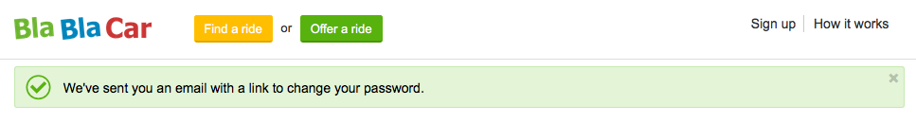
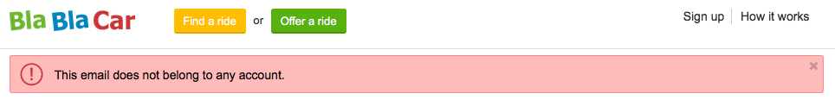
Yep, this email has an account at BlaBlaCar.
Nope, this email has no account with us.

Slide 22
Solution
Always display a success message
Do not reset passwords more than once a day

Slide 23
Brute Force
Login

Slide 24
Principle
Attacker has (somehow) obtained a member’s email.
He also possesses a list of common passwords.
He tries to log in using the email he’s obtained and the whole list of passwords.

Slide 25
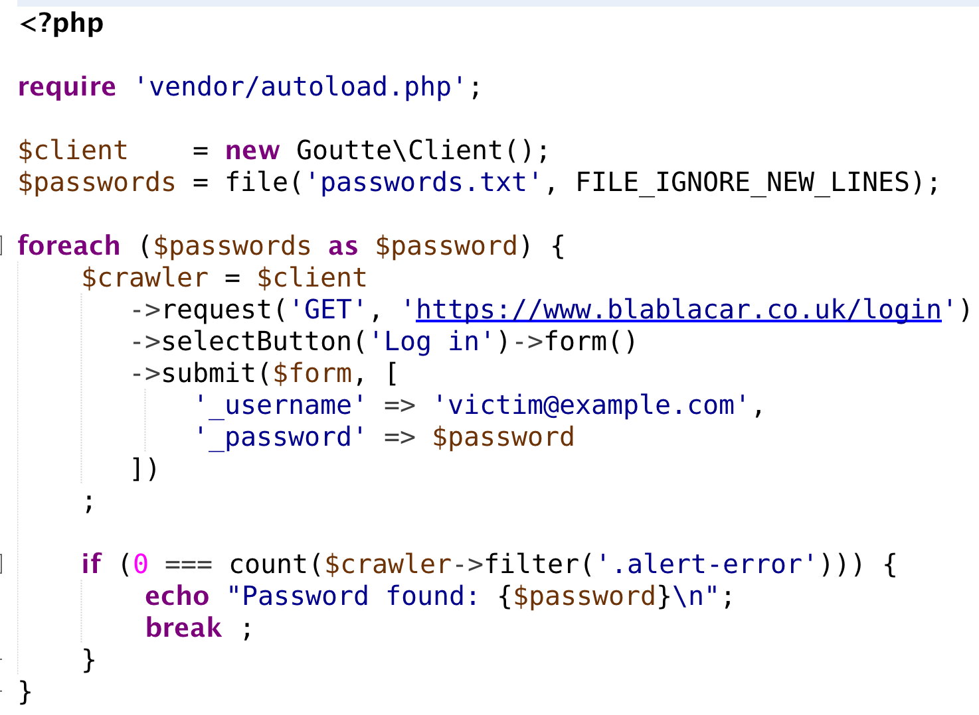
Testing a dictionary of passwords is as simple as that.
Thanks Fabien!

Slide 26
Solution
Limit number of login tries

Slide 27
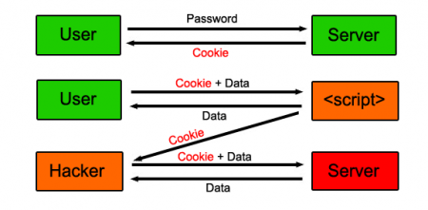
Cross-Site Scripting

Slide 28
Hacker’s goal
Code injection

Slide 29
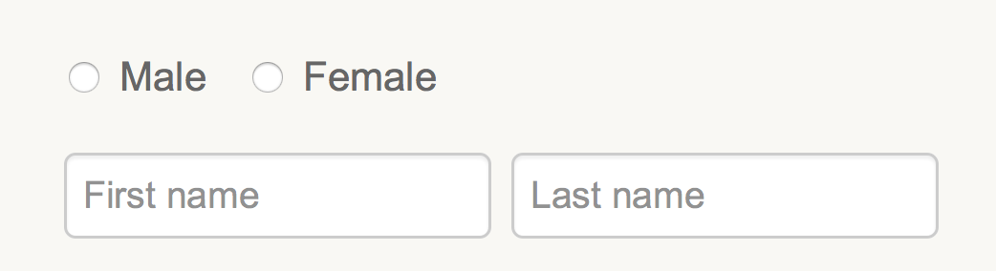
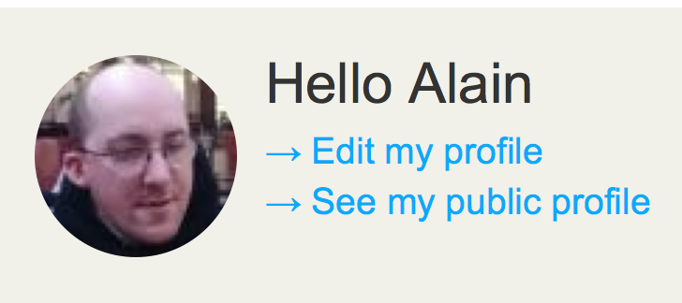
We need to gather information...
And we display them back.

Slide 30
Unsafe code looks like:
What if hacker sets his name to:

Slide 31
Even worse:

Slide 32
Solutions
Proper escaping strategy taking care of the encoding
Use Twig template engine!

Slide 33
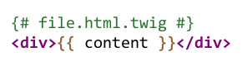
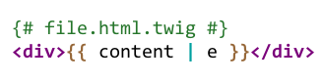
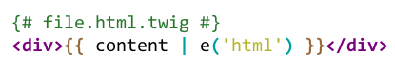
Pitfall: wrong escaping strategy
=
=

Slide 34
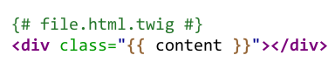

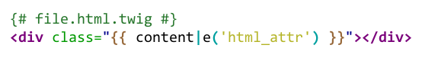

html_attr
A better XML compliance

Slide 35
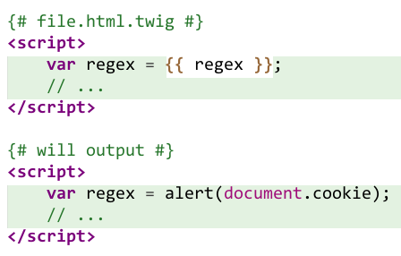
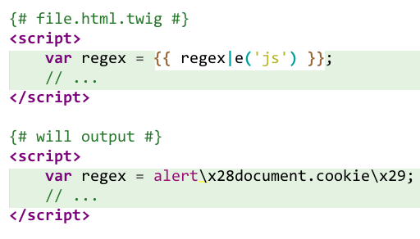
js
alert(document.cookie); in regex?

Slide 36
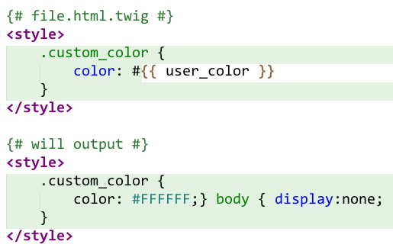
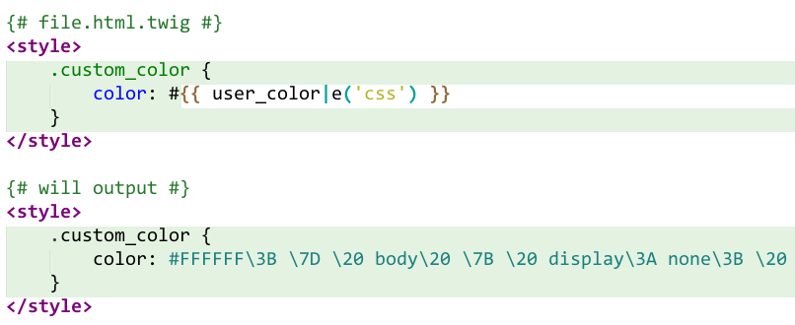
CSS
FFFFFF;} body { display:none; in user_color?

Slide 37
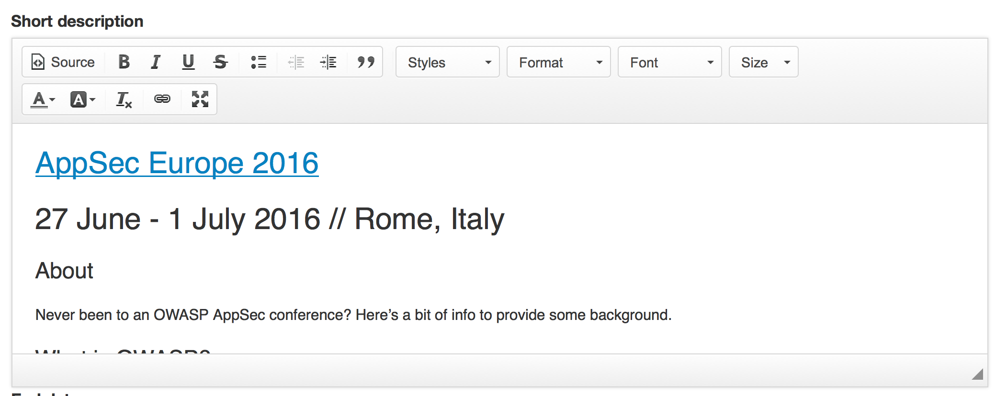
Pitfall: rich-text editors

Slide 38
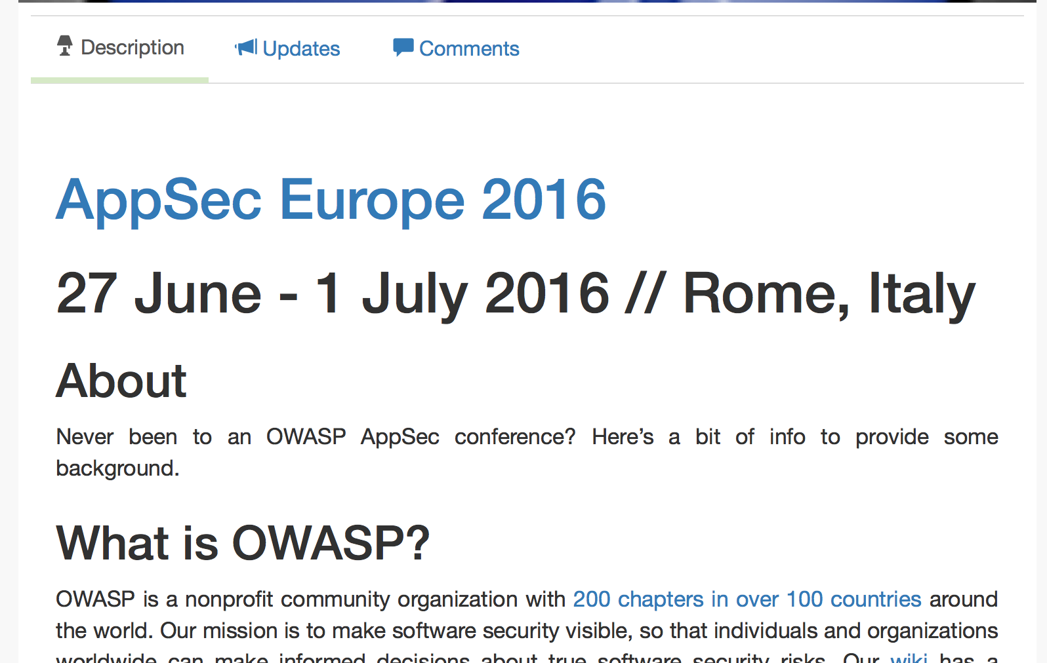
When displaying back the given content, we should keep this beautiful formatting...

Slide 39
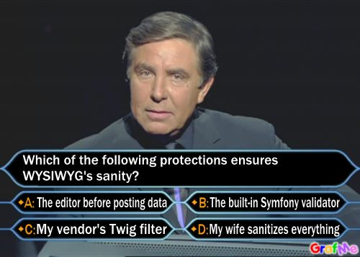

Slide 41
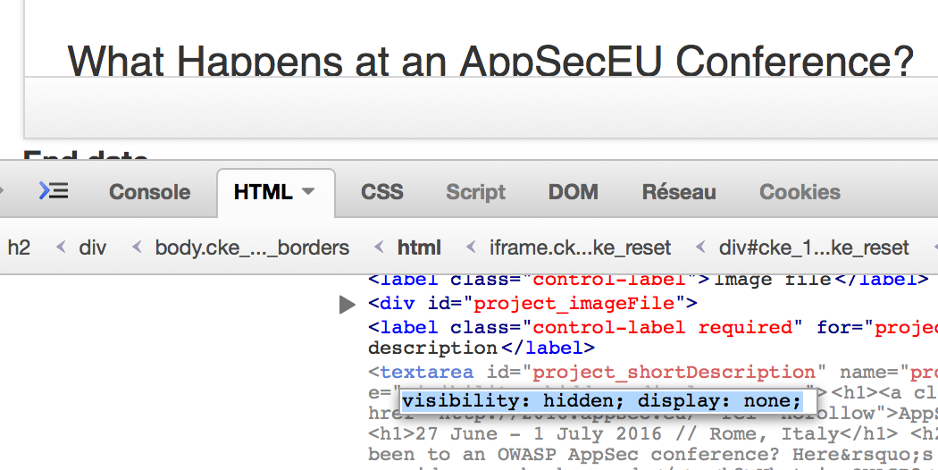
Disable JavaScript

Slide 42
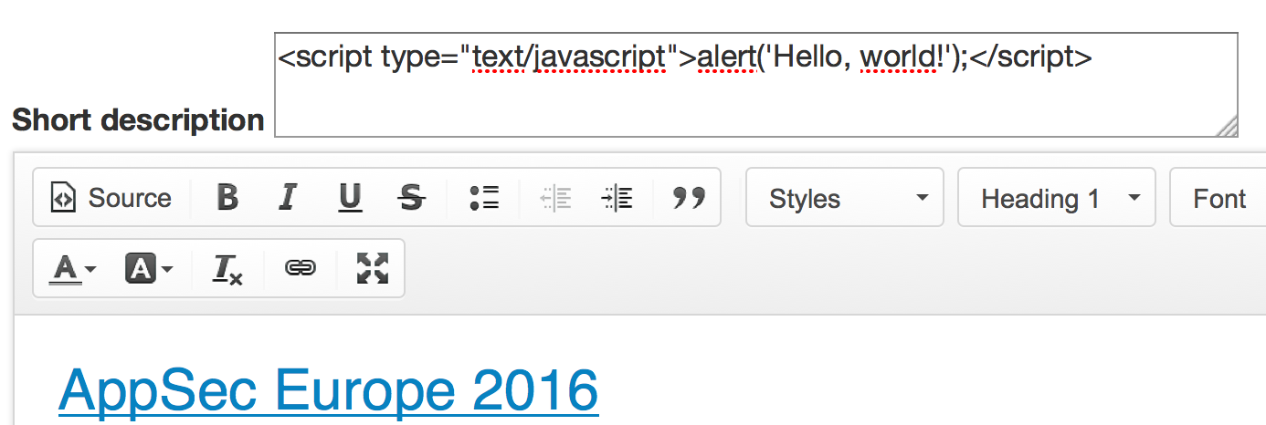
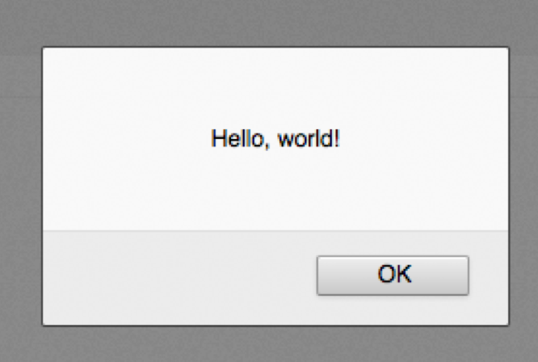
Inject what you want

Slide 44
No Built-in WYSIWYG Validator
Client-Side editors.
No generic solution.

Slide 45
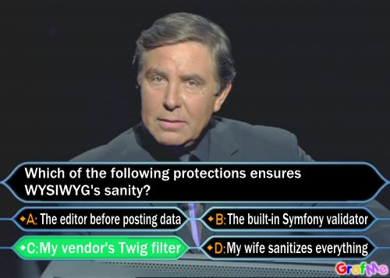

Slide 46

Solutions
sanitize data using HTMLPurifier ( http://htmlpurifier.org/ )
use HTMLPuriferBundle and |purify filter in Symfony

Slide 47
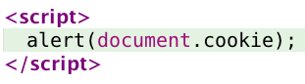
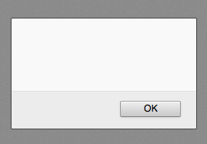
Use HttpOnly cookies

Slide 49
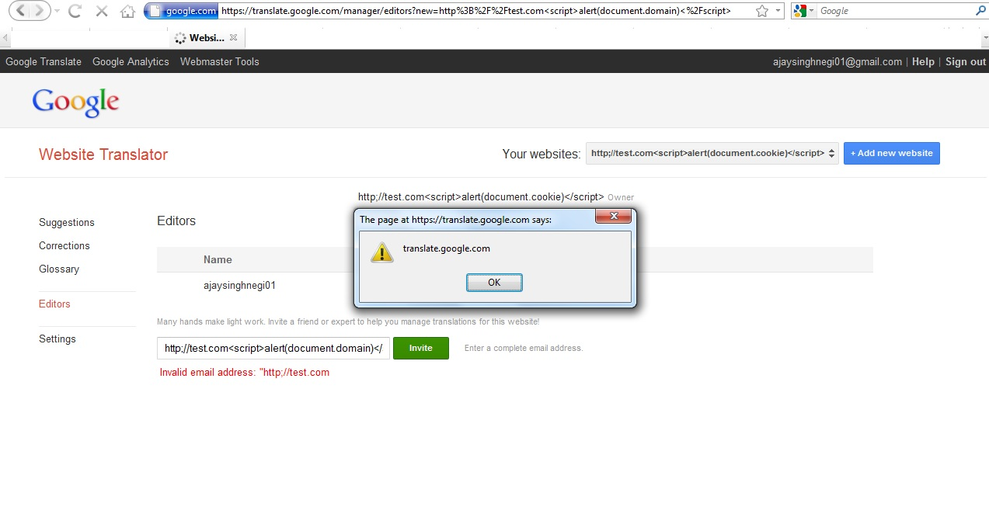
It doesn’t only happen to others

Slide 50
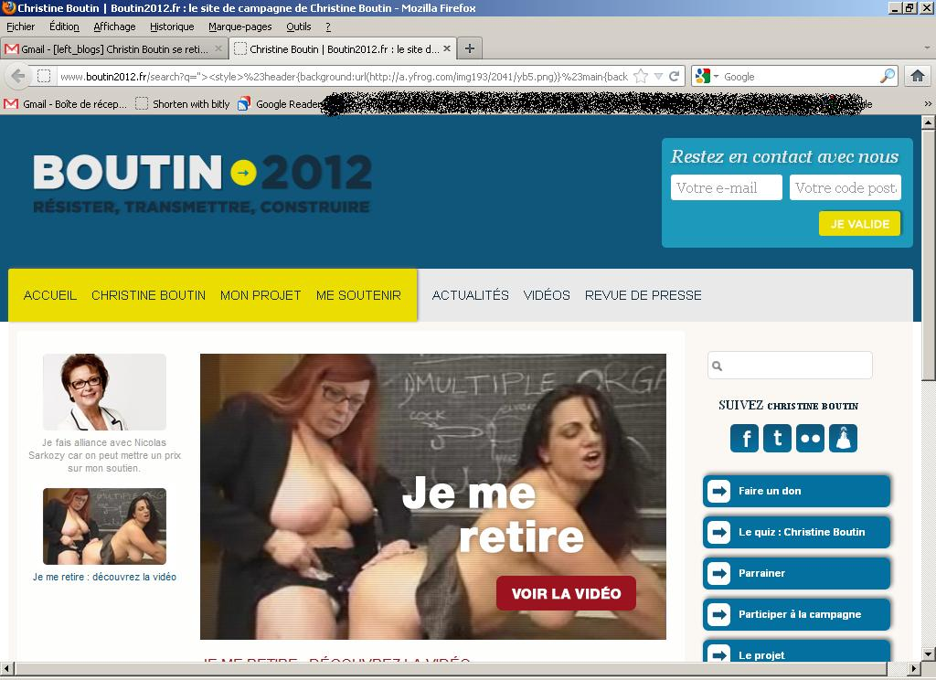

Slide 51
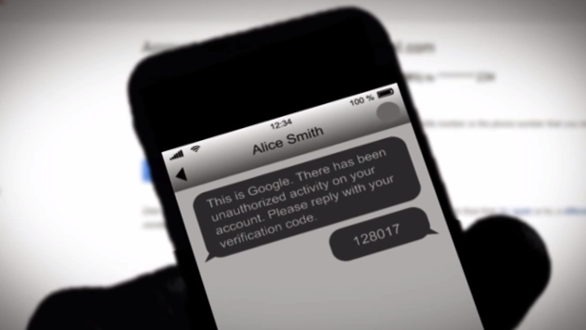
SMS Verification Hacks

Slide 52
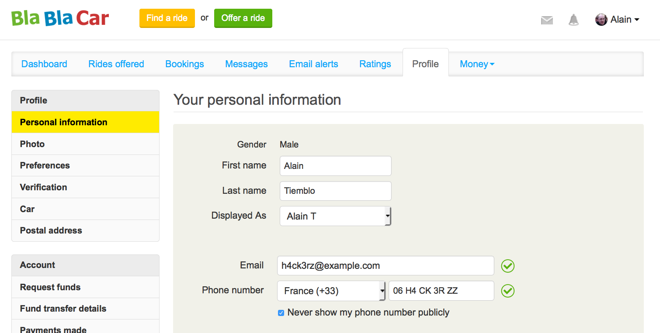
Protect profile changes

Slide 53
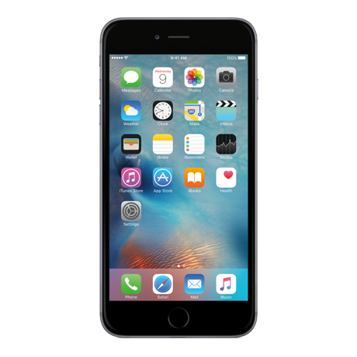

Solution
****
Phone Change
Email Change
****

Slide 54
Solutions
Send an SMS to the old phone number

Slide 55
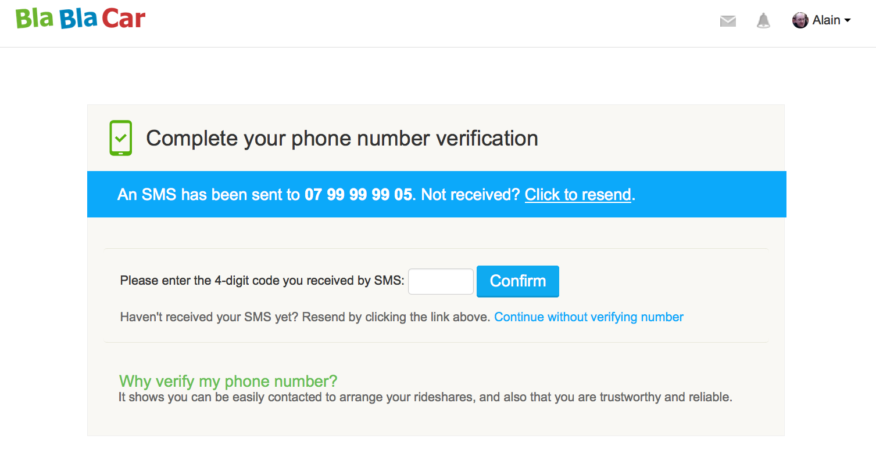

PIN form bruteforcing

Slide 56
Solutions
Stop validating codes after a certain number of attempts.
Invalidate code after a short period of time.

Slide 57

SMS Flooding

Slide 58
Solutions
Limit number of “Resend” uses.

Slide 59
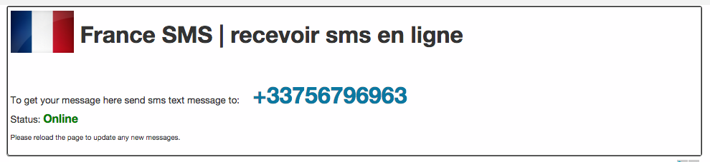

Disposable phone numbers
Beware: yopmail for phones exists!

Slide 60


Solutions
Validate phone numbers legitimacy.

Slide 61
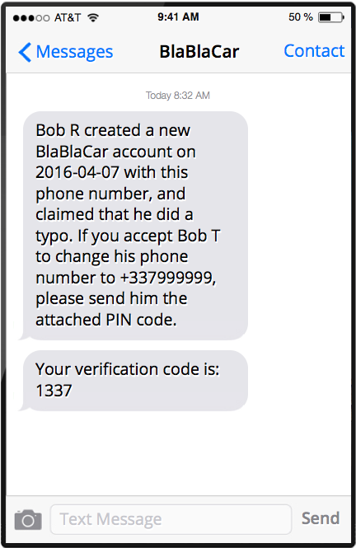
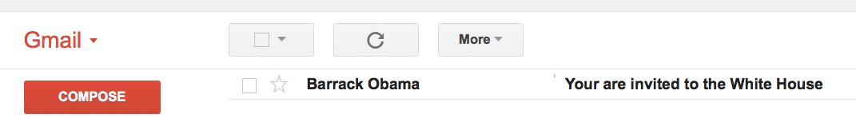
SenderID Spoofing

Slide 62
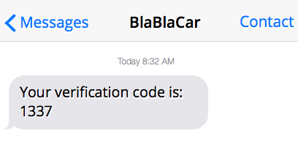
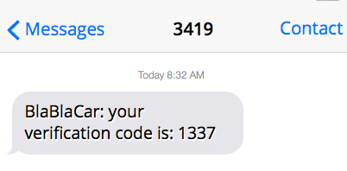
Don’t use brands as SenderID

Slide 63
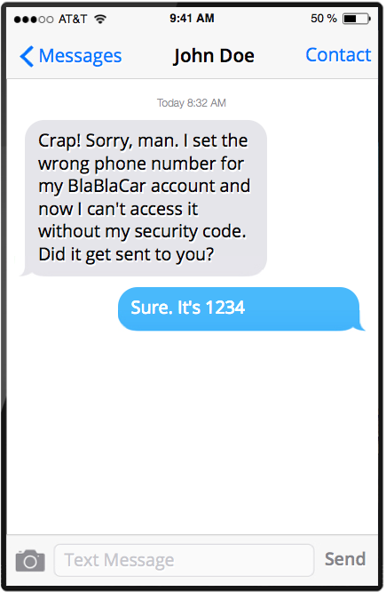

Social Engineering…
...because humans are easy to crack!

Slide 64
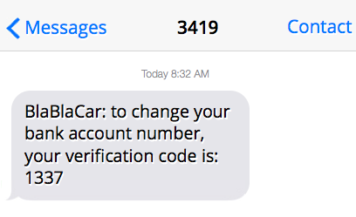
Give context!

Slide 65
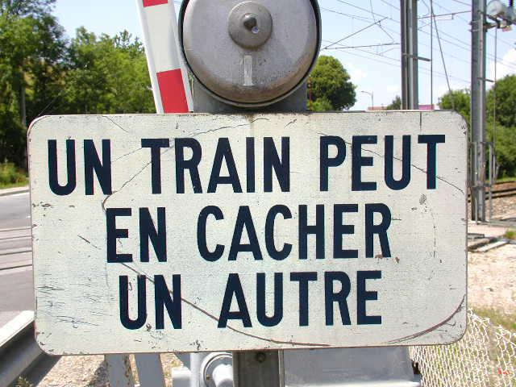

Clickjacking

Slide 66
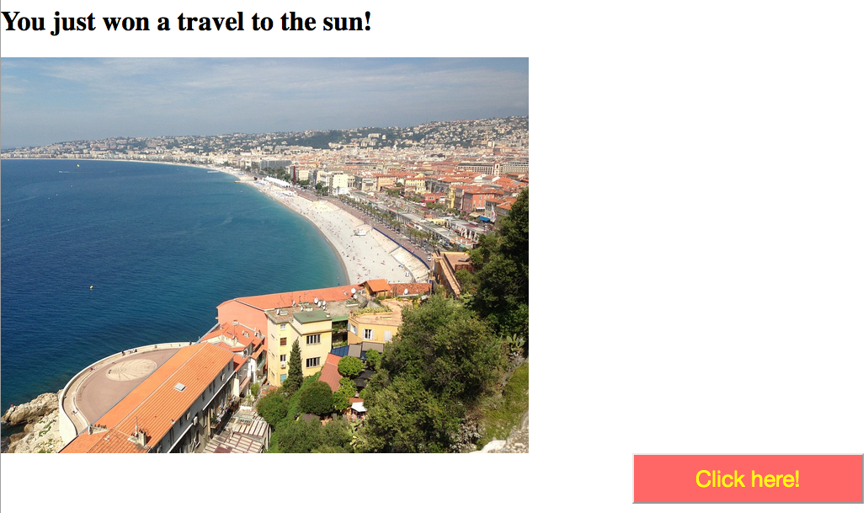

Slide 67
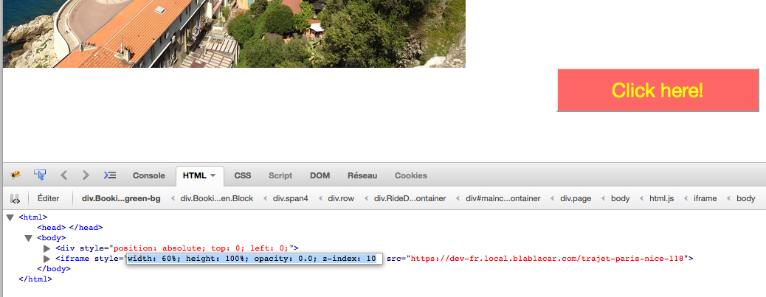

Slide 68
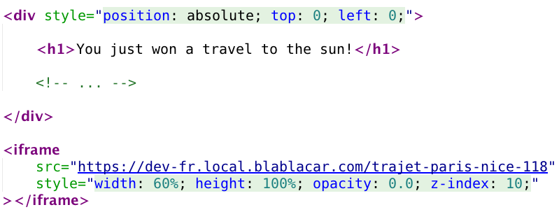

Slide 69
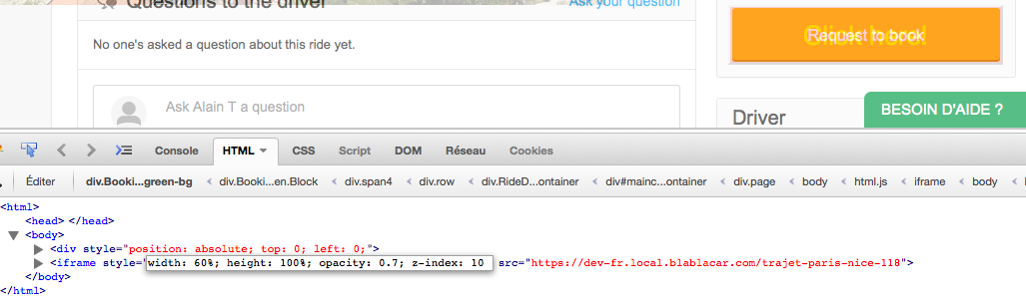

Slide 70
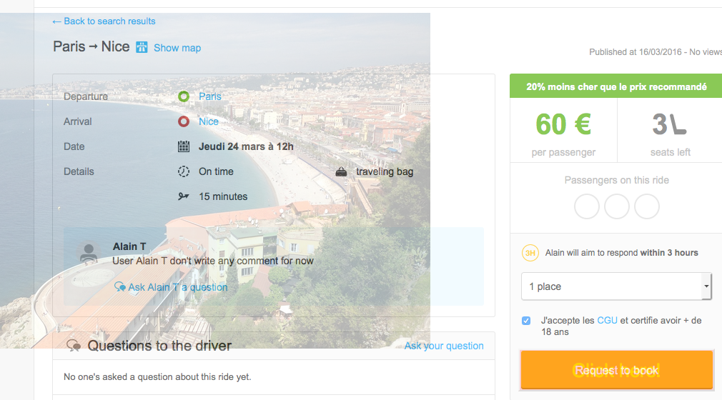

Slide 71


opacity = 0.999
opacity = 0.7
opacity = 0
The Good News:
You’ll travel to the sun anyway!

Slide 72
X-Frame-Options header
X-Frame-Options: SAMEORIGIN
X-Frame-Options: DENY

Slide 73

JavaScript

Slide 74


Slide 75
Cross-Site Request Forgery
or
CSRF
What the hell are those tokens in my forms!

Slide 76


Slide 77


Slide 78


Slide 79


Slide 81

Use a CSRF token!
By default, Symfony automatically generates tokens in all forms

Slide 82
Don’t forget your login form
Attacker may use his own credentials to log-in a user.

Slide 83
Don’t forget your logout buttons
Attacker can exploit this kind of vulnerability to chase users away.

Slide 84

Website Crawling

Slide 85
Attacker’s objectives
Study business’ market
Create a phishing website with real data
Gather content for resell

Slide 86
Hard to protect
Regular users should not be impacted
No generic solution

Slide 87










Counting sessions per IP
= IP
= Session
Time interval

Slide 88
Counting visits per session
= IP
= Session
Time interval

Slide 89
Website Crawling
Does user uses proxies?
If $_SERVER ($request->server->get() in Symfony) contains one of the following keys, answer is YES.
CLIENT_IP, FORWARDED, FORWARDED_FOR, FORWARDED_FOR_IP, HTTP_CLIENT_IP, HTTP_FORWARDED, HTTP_FORWARDED_FOR, HTTP_FORWARDED_FOR_IP, HTTP_PC_REMOTE_ADDR, HTTP_PROXY_CONNECTION', HTTP_VIA, HTTP_X_FORWARDED, HTTP_X_FORWARDED_FOR, HTTP_X_FORWARDED_FOR_IP, HTTP_X_IMFORWARDS, HTTP_XROXY_CONNECTION, VIA, X_FORWARDED, X_FORWARDED_FOR
High-anonymous proxies are rare.

Slide 90



Hiding a strategy on an image

Slide 91

Javascript execution

Slide 92
Scoring
Give a score to all violated rules
Display a captcha (or other) when scores reach your limit

Slide 93
A final word

Slide 94


BlaBlaCar is Hiring!
In a very stressful environment ;)
Passionate about Web Security?
Come and see me!
Motivated to join an innovative and fast-growing international company?
Meet us at our stand!

Slide 95


Questions
Detailed slides soon available at:
https://goo.gl/zByw3v
Notes:
THANK YOU!

Slide 96
Want to go further?
@ninsuo
ninsuo@gmail.com
https://github.com/ninsuo
http://ninsuo.com

Slide 97


Thanks!
Follow me!
@nbrusson
Notes:
THANK YOU!

